Slide 1
Course Overview
Goal: Learn principles/techniques in algorithm design & analysis.
  design: different techniques: recursion, divide and conquer, greedy method, dynamic programming, linear programming
  analysis: correctness, lower bound and complexity
Foundations ch. 2-4, 7, 9.
  loop invariant, divide and conquer
  growth of functions
  recurrences
  lower bound of comparison based sort algorithms
Dynamic programming, ch. 15
Greedy algorithms, ch. 16, 23
Linear programming, ch. 29
NP-complete, ch. 34
Prerequisites: discrete math, data structure, and linear algebra

Slide 2
Two kinds of applications/problems
Non optimization problem vs Optimization problem with an objective
Non optimization problem
    Sorting
    Matrix multiplication
    Interested in designing a fastest algorithm to find a solution
Optimization problem with an objective
    UPS delivery: minimizing the delivery time
    Build a house with fixed budget: maximizing inside area
    Interested in
      Finding a solution with the optimal objective value
      Fastest algorithm
Problem size: number of inputs

Slide 3
Ch. 1: Role of Algorithm in Computing
Definition of algorithm: a procedure that maps a set of input of a given application to output.
Application:
  Optimal binary search tree

Slide 4
Chapter 2 Getting Started--Overview
Examine two algorithms for sorting: insertion sort and merge sort.
See how to describe algorithms in pseudo code.
Begin using asymptotic notation to express running-time.
Learn the technique of “divide and conquer” in the context of merge sort.

Slide 5
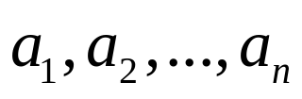
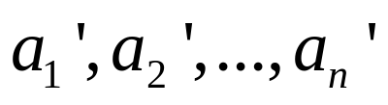
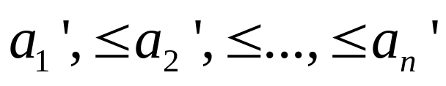
The sorting problem
Input: A sequence of n numbers
Output: A permutation (reordering) of the input sequence such that
  increasing order
  each element: key
Example:

Slide 6
Questions we may ask for this application
How to do sorting?
How many ways to do sorting?
Is my algorithm correct?
Is my algorithm the best?

Slide 7
Insertion Sorting– one of the ways
Basic idea:
  n keys are in array A[1:n]
  assume A[1:j-1] are sorted
  for A[j]: compared against A[1:j-1] & inserted in right place
Example

Slide 8
Express insertion sorting in pseudo code
INSERTION-SORT (A)
1 for j = 2 to A.length
2 key = A[ j ]
3 // Insert A[ j ] into the sorted sequence A[1 ..j -1]
4 i = j -1
5 while i >0 and A[i ] >key
6 A[i +1] = A[i ]
7 i = i -1
8 A[i +1] = key
Is the above algorithm correct? How to prove

Slide 9
Algorithm analysis: correctness
Loop invariant method: Similar to mathematics induction with 3 steps: base, assumption, induction
Basic idea: show four steps
  Identity the loop invariant
  Initialization: It is true prior to the first iteration of the loop (assumption)
  Maintenance: If it is true before an iteration of the loop, it remains true before the next iteration (induction)
  Termination: When the loop terminates, the invariant gives us a useful property that shows the algorithm is correct.
  ‘it’ means the loop invariant of the algorithm
The loop invariant of the insertion sorting: At the start of each iteration of the for loop indexed by j , sub-array A[1 ...j -1] consists of the elements originally in A[1 ..j -1] but in sorted order.

Slide 10
Proof of correctness: insertion sort
The loop invariant: sub-array A[1 ...j -1] consists of the elements originally in A[1 ..j -1] but in sorted order
Initialization: Before iteration 1, j =2, A[1 ...j -1]=A[1],
  the element originally in A[1]
  sorted.
Maintenance--need to prove a loop invariant
  inner while loop works by moving A[ j -1], A[ j -2], A[ j -3] ..., by one position to right until the proper position for key (= A[ j ]) is found, key is placed into this position.
Termination: Outer for loop ends when j =n+1.
  current sub-array A[1 ..n] consists of the elements originally in A[1 ..n] but in sorted order.
  => the entire array is sorted!

Slide 11
Algorithm analysis: running time (time complexity)
Running time (time complexity) is measured by the number of an operation that take constant time such as
  multiplication, division, comparison, ...
Problem (input) size: = n in sorting problem
  parameter that describes the size of input data.
For the comparison based sorting algorithms, the time complexity is measured by the number of

Slide 12
What are missing from the model?
Memory hierarchy
  different algorithms show different data locality => different cache miss penalty.

Slide 13
Complexity(running time) analysis of insertion sort
INSERTION-SORT (A)
1 for j = 2 to A.length
2 key = A[ j ]
3 // Insert A[ j ] into the sorted sequence A[1 ..j -1]
4 i = j -1
5 while i >0 and A[i ] >key
6 A[i +1] = A[i ]
7 i = i -1
8 A[i +1] = key

Slide 14

Complexity analysis-- insertion sort
# comparisons while loop executes in iteration j.
T (n) = running time of INSERTION-SORT = # comparisons
: varies depending on input
Best case:
Worst case:
Average case:

Slide 15

Order of growth
Another abstraction to ease analysis and focus on the important features.
Look only at the leading term of the formula for running time.
  drop lower-order terms.
  ignore the constant coefficient in the leading term.
Example: For insertion sort, the worst-case running time is
Drop lower-order terms
Ignore constant coefficient
The worst-case running time
  Meaning: It grows like it does not equal

Slide 16
Observation from insertion sort

Slide 17
Algorithm design techniques
Insertion sort: incremental
Merge sort: divide & conquer--basic idea
  divide the problem into 2 sub problems
  conquer the sub problems recursively
  combine sub problems
  example:

Slide 18
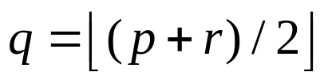
Merge sort
MERGE-SORT (A, p, r)
if p <r #Check base case
then #Divide
MERGE-SORT (A, p, q) #Conquer
MERGE-SORT (A, q +1, r ) #Conquer
MERGE (A, p, q, r ) #Combine
Initial call: MERGE-SORT (A, 1, n)

Slide 19

Merge procedure?
Input: Array A and indices p, q, r,
  A[ p ..q] & A[q +1 ..r]: sorted, neither sub array is empty.
Output: two subarrays are merged into a single sorted subarray A[ p ..r].
Idea behind merging: Think of two piles of cards.
  each pile is sorted and placed face-up on a table with the smallest cards on top
  we will merge these into a single sorted pile, face-down on the table.

Slide 20



Merge procedure -continued
A basic step:
  choose the smaller of the two top cards.
  remove it from its pile, thereby exposing a new top card.
  Place the chosen card onto the output pile.
Repeatedly perform basic steps until one input pile is empty.
Once one input pile empties, just take the remaining input pile and place it onto the output pile.
Each basic step should take constant time
There are basic steps,
Therefore, this procedure should take time.
To avoid checking emptiness of input piles--place two sentinel cards at end of each pile.

Slide 21
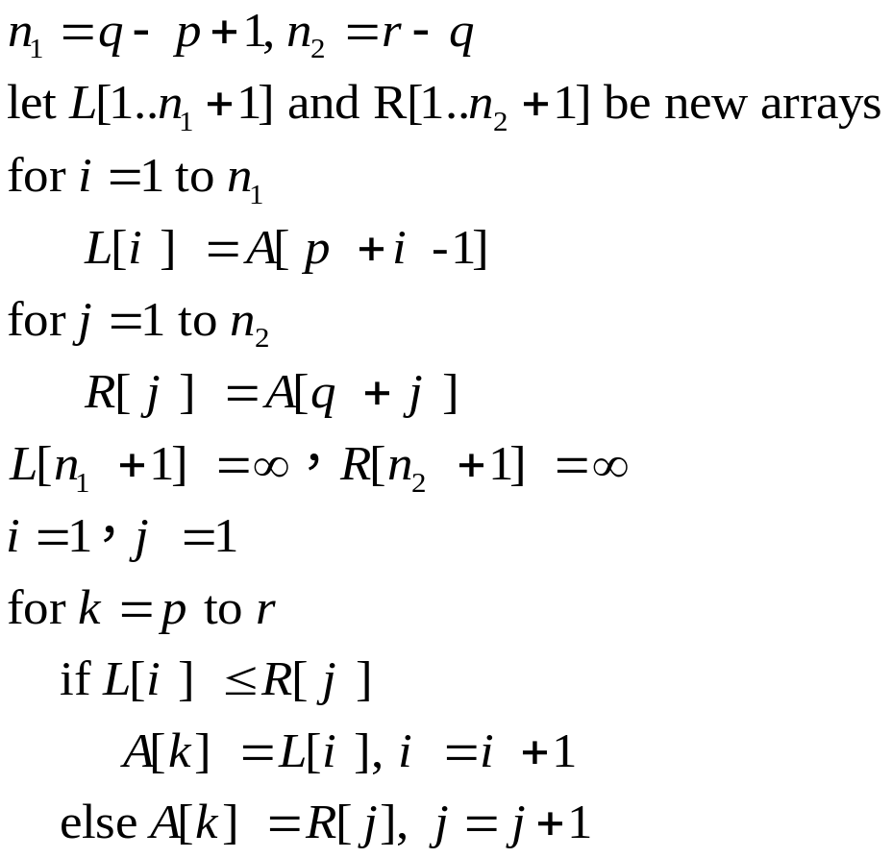
Merge procedure--pseudo code
MERGE (A, p, q, r)

Slide 22
Example

Slide 23
Merge sort, complexity
MERGE-SORT (A, p, r)
if p <r
then
MERGE-SORT (A, p, q)
MERGE-SORT (A, q +1, r )
MERGE (A, p, q, r )
Initial call: MERGE-SORT (A, 1, n)

Slide 24
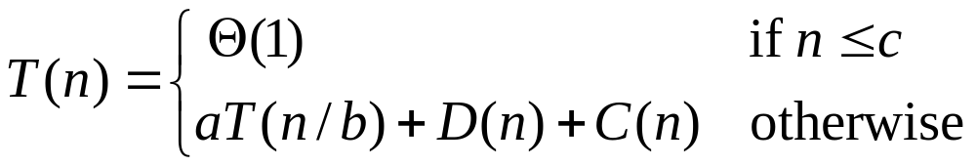
Analyzing divide-and-conquer algorithms
Use a recurrence to describe the running time of a divide-and-conquer algorithm.
Let T (n )= running time on a problem of size n.
Suppose divide into a subproblems with size n/b
  example: in merge sort, a =b =2
Let the time to divide a size-n problem be D(n)
Each subproblem takes T(n/b) , there are a subproblems to solve, => aT(n/b) time solving subproblems.
Let the time to combine solutions be C (n)
Base case: takes constant, then

Slide 25
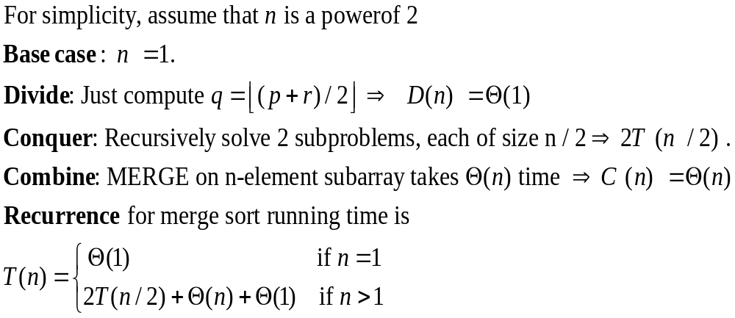
Analyzing merge sort

Slide 26
How to solve the recurrence?

Slide 27
Chapter 2 summary
What we will learn from this course
  algorithm design, different techniques
    incremental
    divide & conquer
    dynamic programming
    greedy method
    linear programming
  algorithm analysis, correctness, complexity
  is the current design the best--lower bound
Insertion sort--incremental
Merge sort--divide & conquer
Loop invariant

